Slide 1
Chapter 4:
Networking and the Internet
Computer Science: An Overview
Eleventh Edition
by
J. Glenn Brookshear

Slide 2
Chapter 4: Networking and the Internet
4.1 Network Fundamentals
4.2 The Internet
4.3 The World Wide Web
4.4 Internet Protocols
4.5 Security
0-<number>

Slide 3
Network Classifications
Scope
  Local area network (LAN)
  Metropolitan area (MAN)
  Wide area network (WAN)
Ownership
  Closed versus open
Topology (configuration)
  Bus (Ethernet)
  Star (Wireless networks with central Access Point)
0-<number>

Slide 4
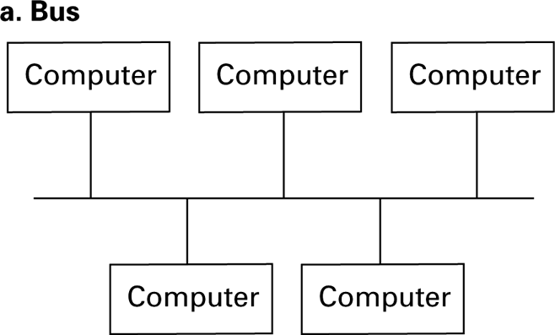
Figure 4.1 Network topologies
0-<number>

Slide 5
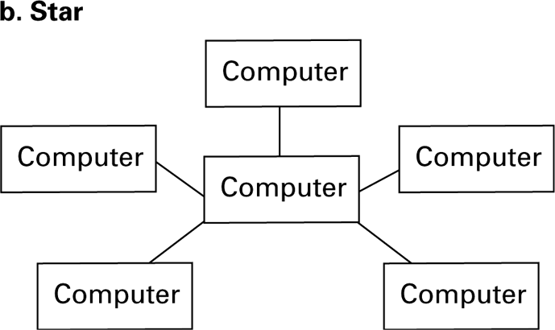
Figure 4.1 Network topologies (continued)
0-<number>

Slide 6
Protocols
CSMA/CD
  Used in Ethernet
  Silent bus provides right to introduce new message
CSMA/CA
  Used in WiFi
  Hidden terminal problem
0-<number>

Slide 7
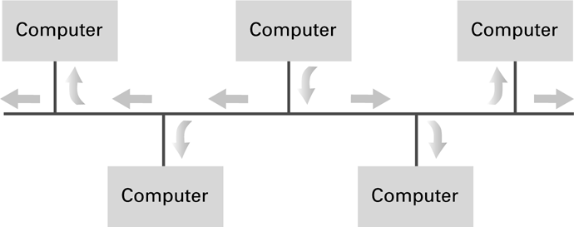
Figure 4.2 Communication over a bus network
0-<number>

Slide 8
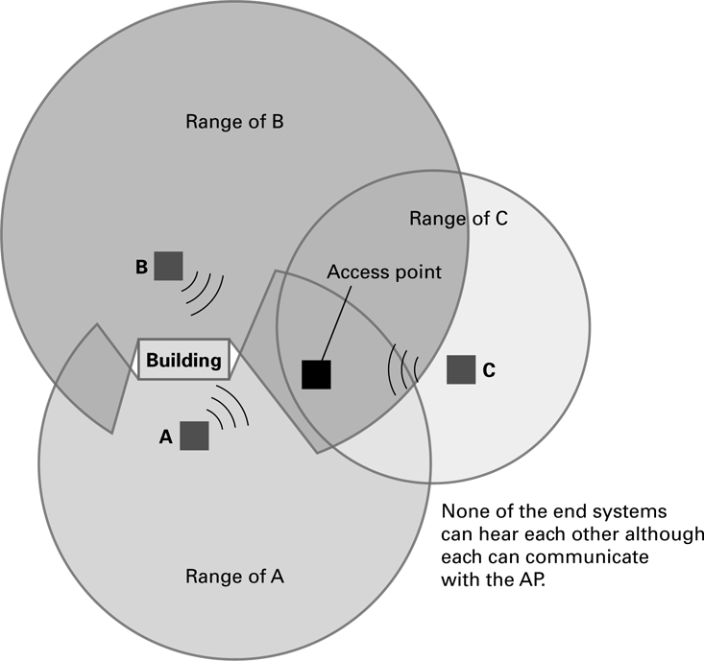
Figure 4.3 The hidden terminal problem
0-<number>

Slide 9
Connecting Networks
Repeater: Extends a network
Bridge: Connects two compatible networks
Switch: Connects several compatible networks
Router: Connects two incompatible networks
resulting in a network of networks called an
internet
0-<number>

Slide 10
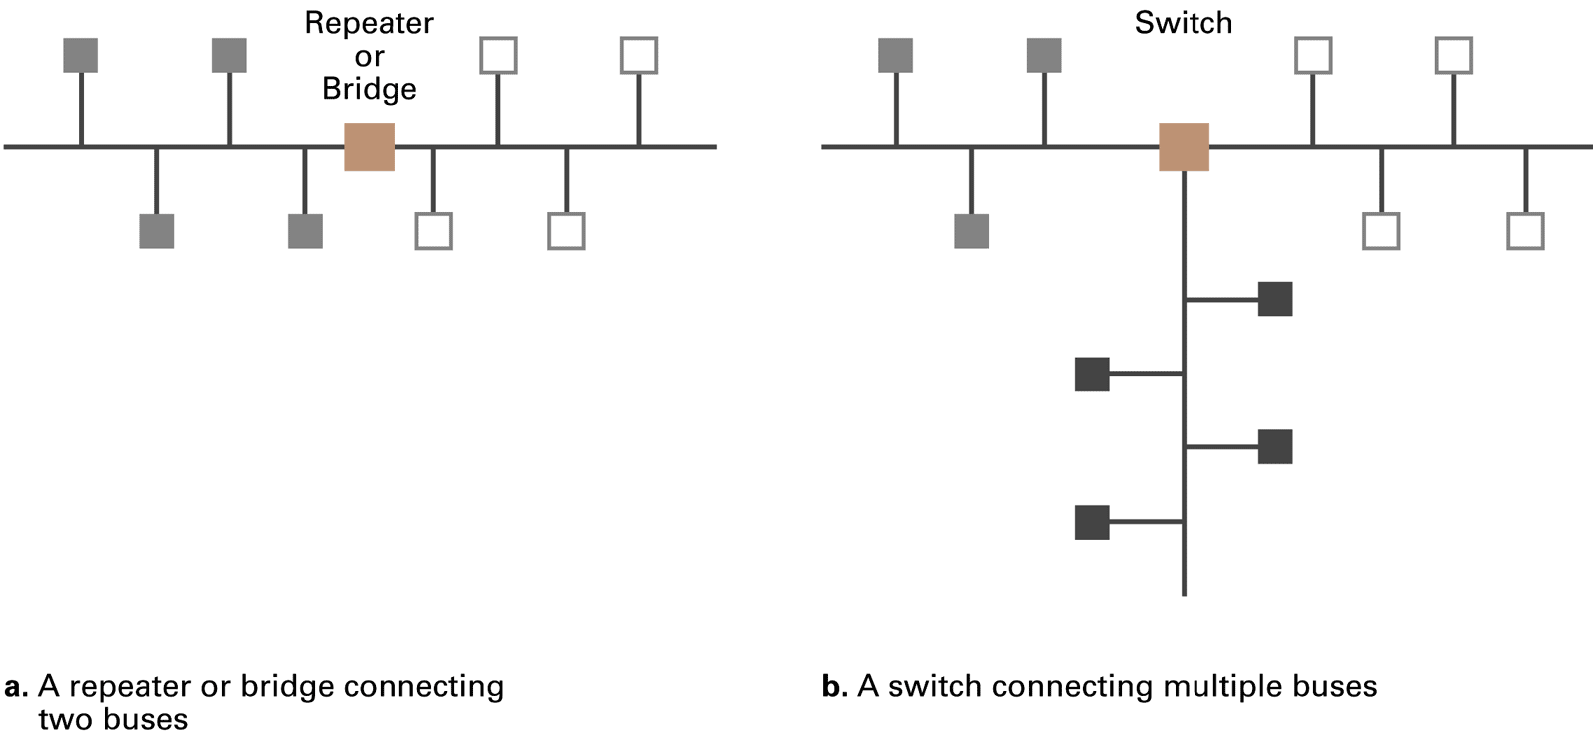
Figure 4.4 Building a large bus network from smaller ones
0-<number>

Slide 11
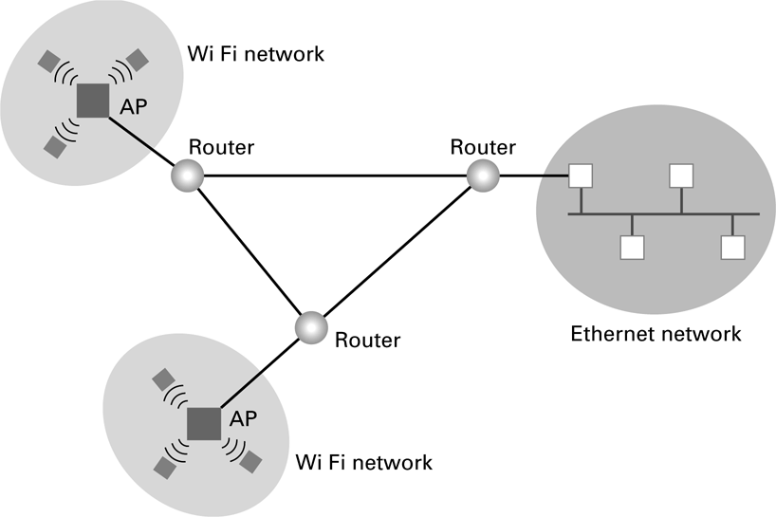
Figure 4.5 Routers connecting two WiFi networks and an Ethernet network to form an internet
0-<number>

Slide 12
Inter-process Communication
Client-server
  One server, many clients
  Server must execute continuously
  Client initiates communication
Peer-to-peer (P2P)
  Two processes communicating as equals
  Peer processes can be short-lived
0-<number>

Slide 13
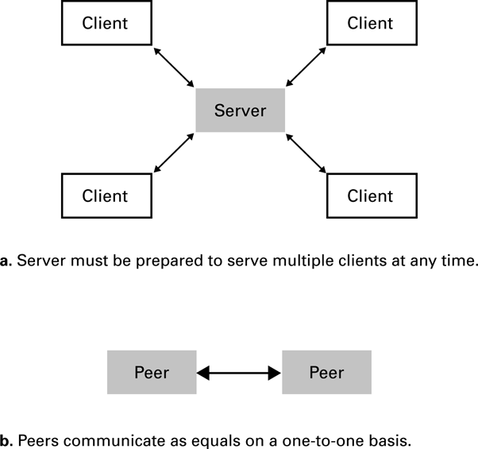
Figure 4.6 The client/server model compared to the peer-to-peer model
0-<number>

Slide 14
Distributed Systems
Systems with parts that run on different computers
  Infrastructure can be provided by standardized toolkits
    Example: Enterprise Java Beans from
    Oracle
    Example: .NET framework from Microsoft
0-<number>

Slide 15
The Internet
The Internet: An internet that spans the world
  Original goal was to develop a means of connecting networks that would not be disrupted by local disasters.
  Today it has shifted from an academic research project to a commercial undertaking.
0-<number>

Slide 16
Internet Architecture
Internet Service Provider (ISP)
  Tier-1
  Tier-2
Access ISP: Provides connectivity to the Internet
  Traditional telephone (dial up connection)
  Cable connections
  DSL
  Wireless
0-<number>

Slide 17
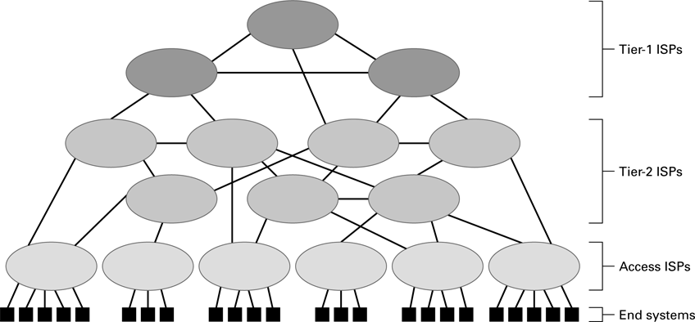
Figure 4.7 Internet Composition
0-<number>

Slide 18
Internet Addressing
IP address: pattern of 32 or 128 bits often represented in dotted decimal notation
Mnemonic address:
  Domain names
  Top-Level Domains
Domain name system (DNS)
  Name servers
  DNS lookup
0-<number>

Slide 19
Internet Corporation for Assigned Names & Numbers (ICANN)
Allocates IP addresses to ISPs who then assign those addresses within their regions.
Oversees the registration of domains and domain names.
0-<number>

Slide 20
Traditional Internet Applications
Electronic Mail (email)
  Domain mail server collects incoming mail and transmits outing mail
  Mail server delivers collected incoming mail to clients via POP3 or IMAP
File Transfer Protocol (FTP)
Telnet and SSH
0-<number>

Slide 21
More Recent Applications
Voice Over IP (VoIP)
Internet Radio
  N-unicast
  Multicast
0-<number>

Slide 22
World Wide Web
Hypertext and HTTP
Browser gets documents from Web server
Documents identified by URLs
0-<number>

Slide 23
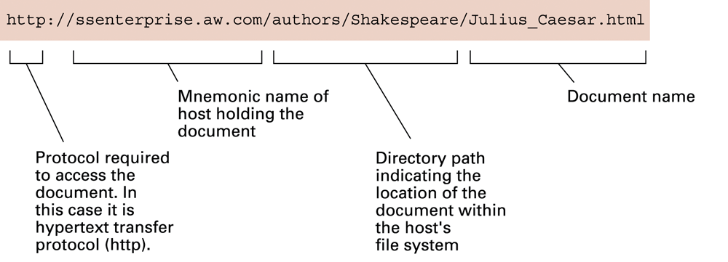
Figure 4.8 A typical URL
0-<number>

Slide 24
Hypertext Document Format
Encoded as text file
Contains tags to communicate with browser
  Appearance
    <h1> to start a level one heading
    <p> to start a new paragraph
  Links to other documents and content
    <a href = . . . >
  Insert images
    <img src = . . . >
0-<number>

Slide 25
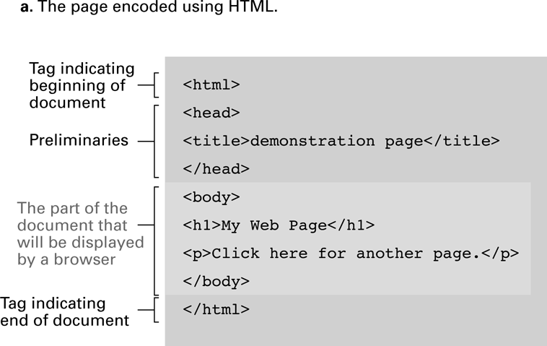
Figure 4.9 A simple Web page
0-<number>

Slide 26
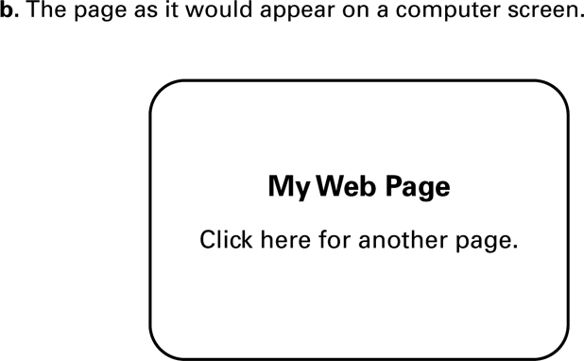
Figure 4.9 A simple Web page (continued)
0-<number>

Slide 27
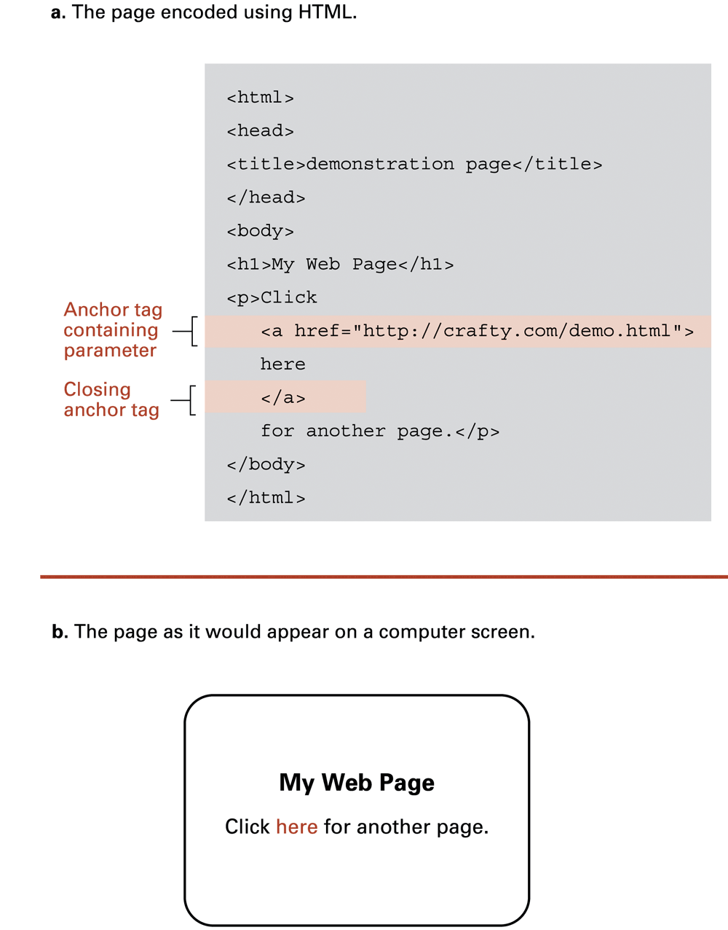
Figure 4.10 An enhanced simple Web page
0-<number>

Slide 28
Figure 4.10 An enhanced simple Web page (continued)
0-<number>

Slide 29
Extensible Markup Language (XML)
XML: A language for constructing markup languages similar to HTML
  A descendant of SGML
  Opens door to a World Wide Semantic Web
0-<number>

Slide 30
Using XML
<staff clef = “treble”> <key>C minor</key>
<time> 2/4 </time>
<measure> < rest> egth </rest> <notes> egth G, egth G, egth G </notes></measure>
<measure> <notes> hlf E </notes></measure>
</staff>
0-<number>

Slide 31
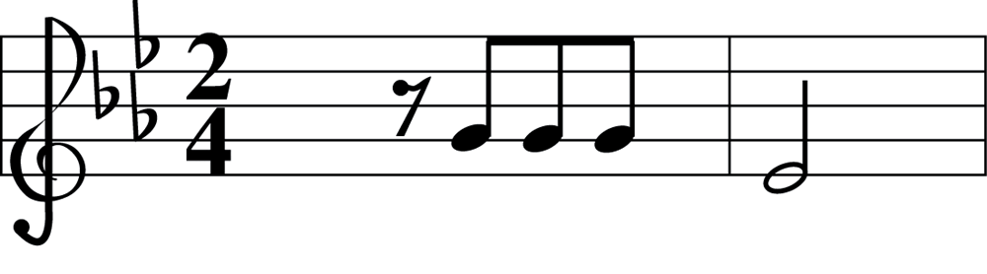
Figure 4.11 The first two bars of Beethoven’s Fifth Symphony
0-<number>

Slide 32
Client Side Versus Server Side
Client-side activities
  Examples: java applets, javascript, Macromedia Flash
Server-side activities
  Common Gateway Interface (CGI)
  Servlets
  PHP
0-<number>

Slide 33
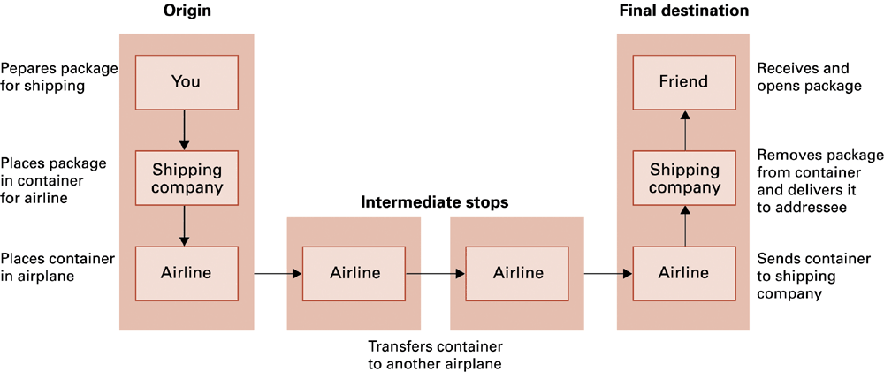
Figure 4.12 Package-shipping example
0-<number>

Slide 34
Internet Software Layers
Application: Constructs message with
address
Transport: Chops message into packets
Network: Handles routing through the
Internet
Link: Handles actual transmission of
packets
0-<number>

Slide 35
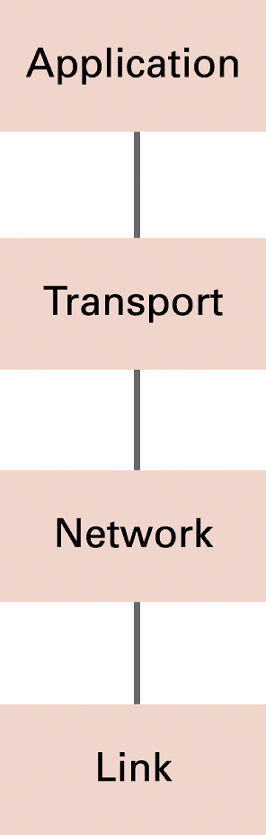
Figure 4.13 The Internet software layers
0-<number>

Slide 36
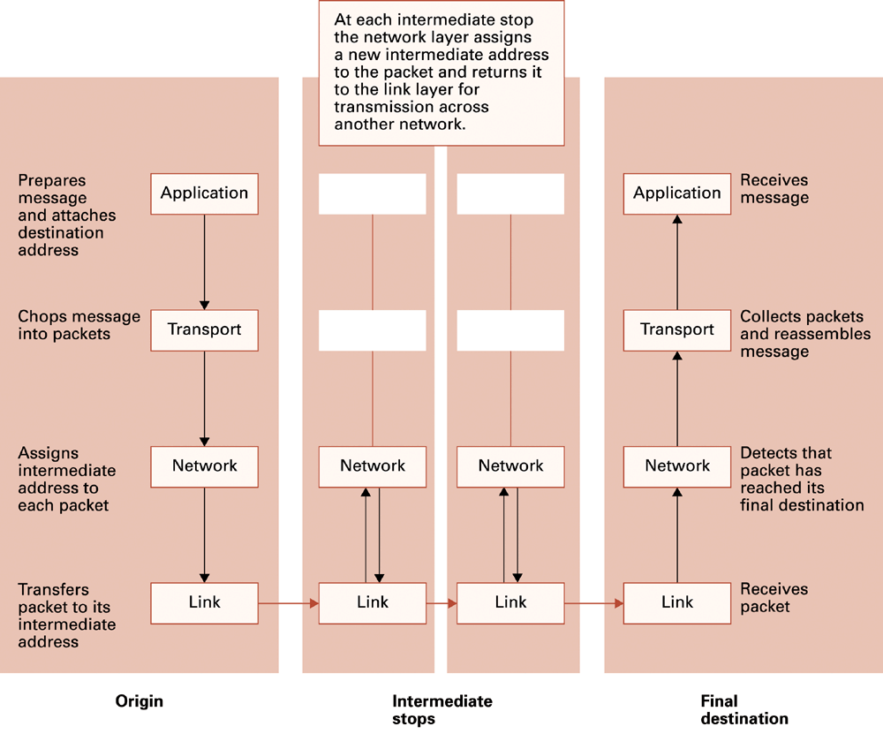
Figure 4.14 Following a message through the Internet
0-<number>

Slide 37
TCP/IP Protocol Suite
Transport Layer
  TCP
  UDP
Network Layer
  IP (IPv4 and IPv6)
0-<number>

Slide 38
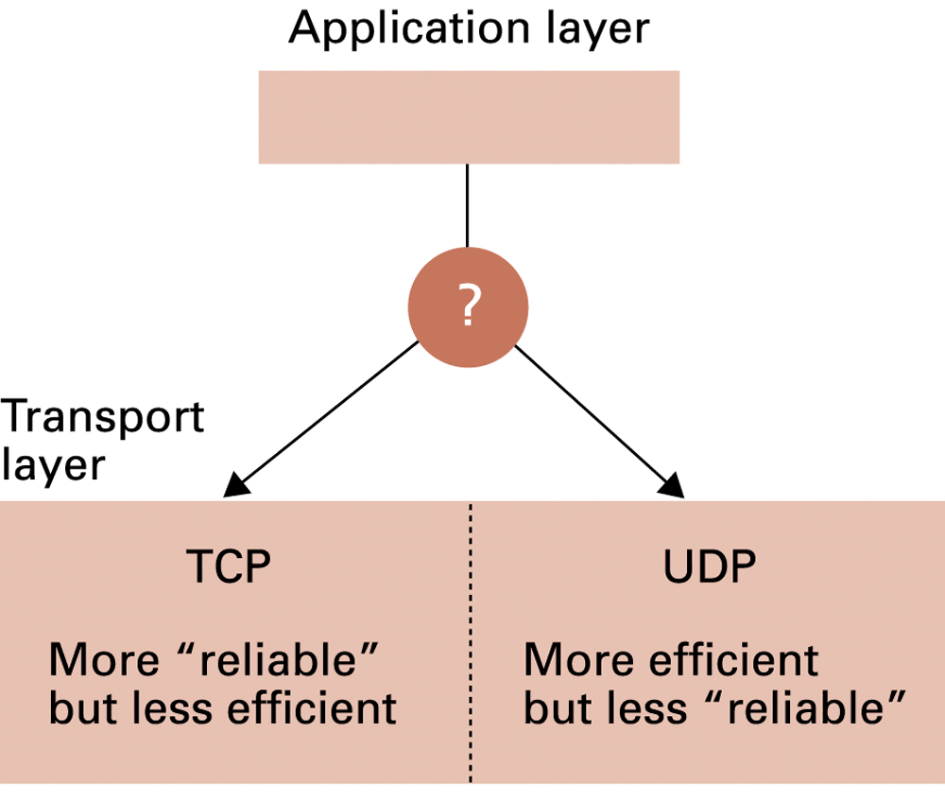
Figure 4.15 Choosing between TCP and UDP
0-<number>

Slide 39
Security
Attacks
  Malware (viruses, worms, Trojan horses, spyware, phishing software)
  Denial of service
  Spam
Protection
  Firewalls
  Spam filters
  Proxy Servers
  Antivirus software
0-<number>

Slide 40
Encryption
FTPS, HTTPS, SSL
Public-key Encryption
  Public key: Used to encrypt messages
  Private key: Used to decrypt messages
Certificates and Digital Signatures
0-<number>

Slide 41
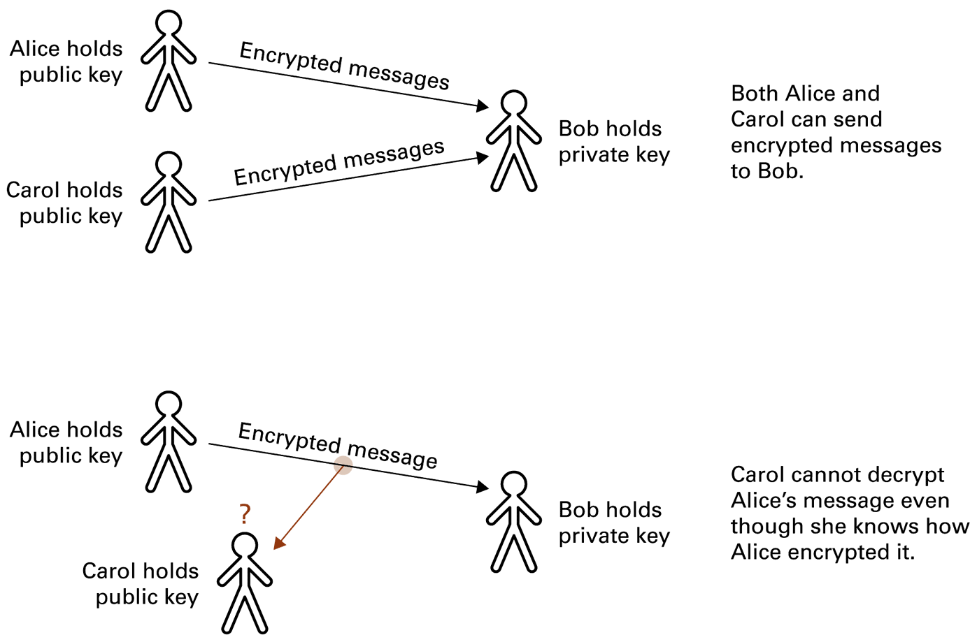
Figure 4.16 Public-key encryption
0-<number>

